Slide 1

AutoCad 2021
د. وميض تركي محمد

Slide 2
في نهاية هذا الدرس يستطيع الطالب أن يتعرف على:
استخدام المجموعة الثانية من ادوات التصحيح Use the 2nd group of editing tools
أنواع الخطوط line types

Slide 3
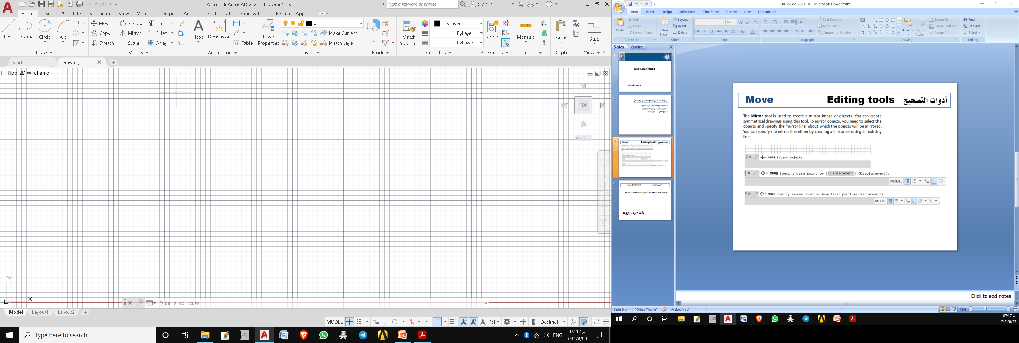
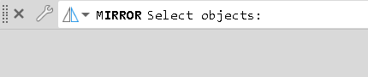
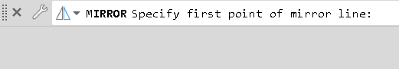
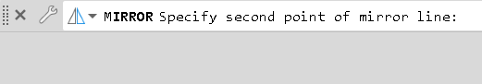

أدوات التصحيح Mirror Editing tools
The Mirror tool is used to create a mirror image of objects. You can create symmetrical drawings using this tool. To mirror objects, you need to select the objects and specify the ‘mirror line’ about which the objects will be mirrored. You can specify the mirror line either by creating a line or selecting an existing line.
Select objects and press Enter
Select first point and press Enter
Select second point and press Enter
Select choose Y to erase the source objects or
N to keep the source objects

Slide 4
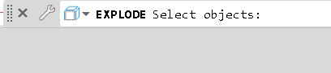
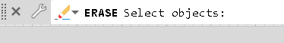
أدوات التصحيح Explode Editing tools
The Explode tool is used to explode a group of objects into individual objects. For example, when you create a drawing using the Polyline tool, it acts as a single object. You can explode a polyline or rectangle or any group of objects using the Explode tool.
Select objects and press Enter
Erase
Select objects and press Enter

Slide 5
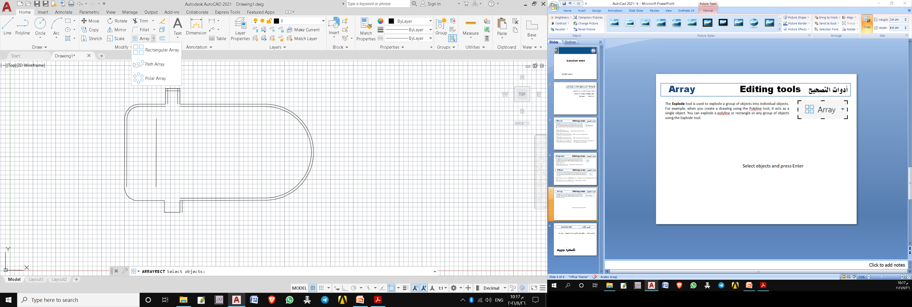
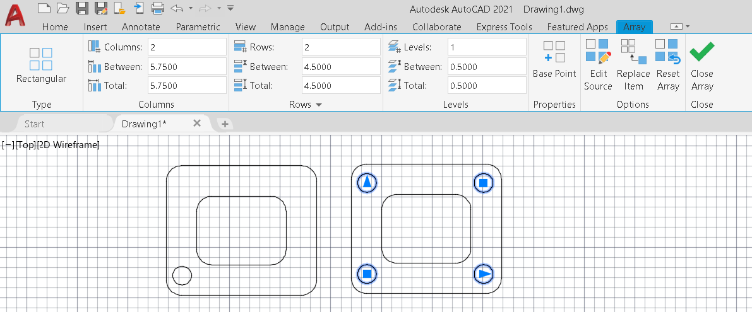
أدوات التصحيح Array Editing tools
The Rectangular Array tool is used to create an array of objects along the X and Y directions.
Select objects and press Enter

Slide 6
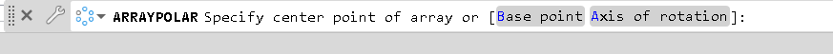
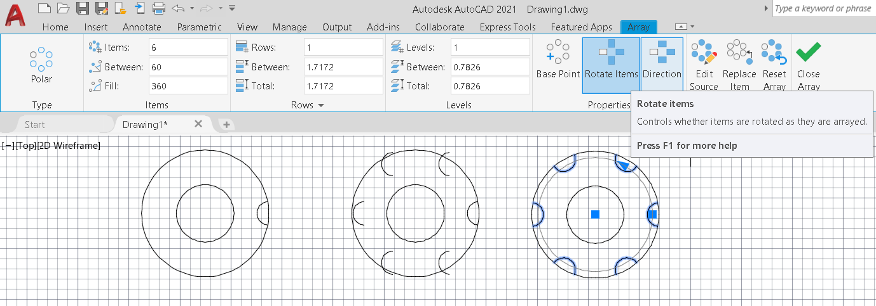
أدوات التصحيح Array Editing tools
The Polar Array tool is used to create an arrangement of objects around a point in circular form. The following example shows you to create a polar array
Specify the center point

Slide 7
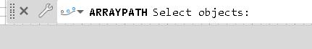
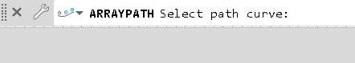
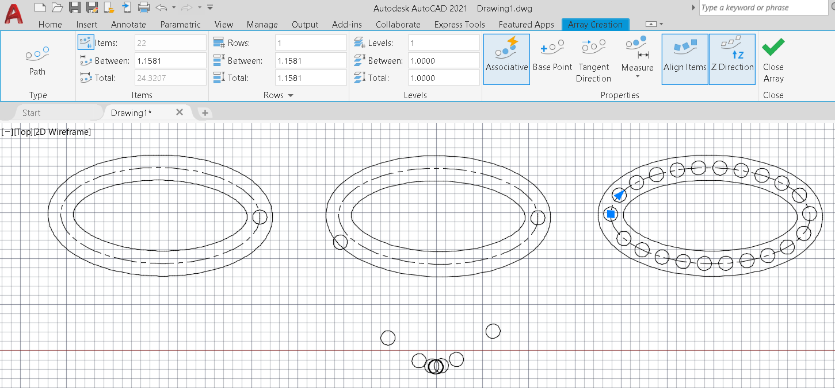
أدوات التصحيح Array Editing tools
The Path Array tool is used to create an array of objects along a path (line, polyline, circle, helix, spline etc.)
Select objects and press Enter
Select path curve and press Enter

Slide 8
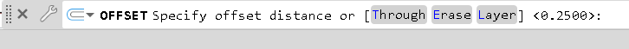
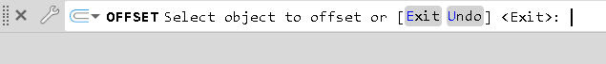
أدوات التصحيح Offset Editing tools
The Offset tool is used to create parallel copies of lines, polylines, circles, arcs and so on. To create parallel copy of an object, first you need to specify the offset distance, and then select the object. Next, you need to specify the side in which the parallel copy will be placed.
Specify the offset distance and press enter
Select objects to offset

Slide 9
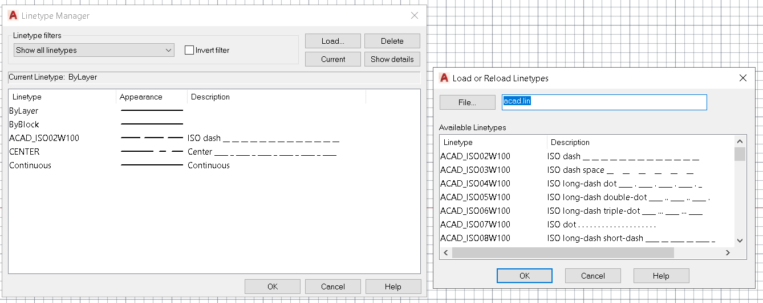
نوع الخط Line Type
Type Linetype in command bar
or choose Linetype from properties panel then choose other
1
Press load
Select the linetype and press ok
or double click on the chosen linetype
2

Slide 10
الدرس القادم ... AutoCAD 2021
في الدرس القادم ... نبدأ بإضافة الطبقات, الابعاد والنصوص الى الرسم... بإذن الله
شكراً جزيلا

